Slide 1


Jan. 22, 2021
Hyperspectral Unmixing
Presenter:
Collaborator: Yu-Chen Lo, Yu-Hsuan Tsai, Luen-Ming Shen
Graduate Institute of Electronics Engineering, National Taiwan University
https://github.com/yhtsai2836/Unmixing

Slide 2
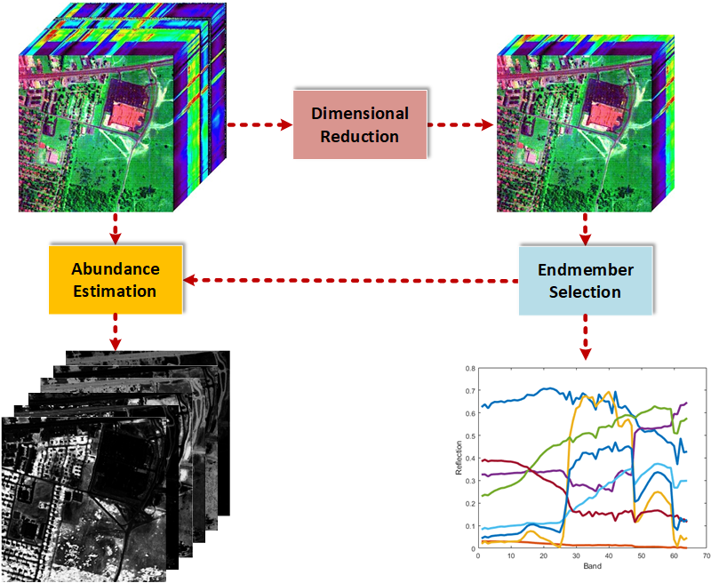
Algorithm
Dimensional Reduction
Endmember Selection
Abundance Estimation

Slide 3
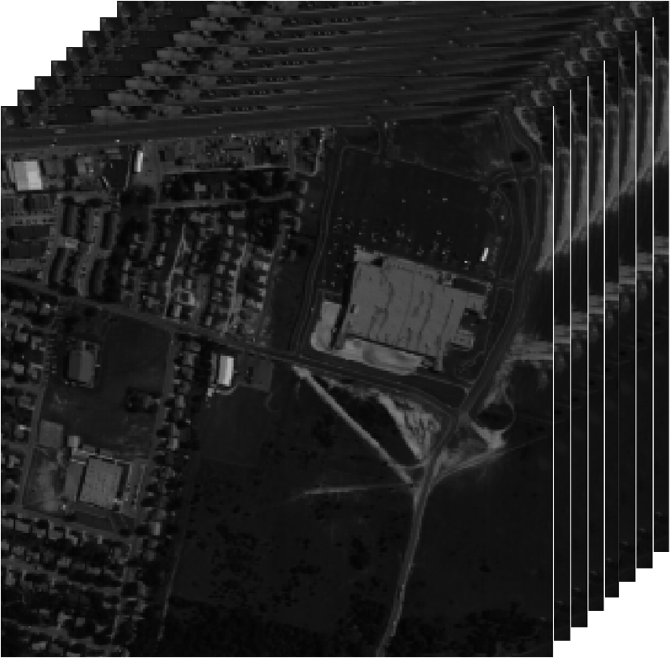
Dataset
Dataset: Hydice
Input image size: 256x256x8
Target frame rate: 10 frames/second

Slide 4
Computation Complexity
Abundance estimation
Iterative matrix multiplication
Multiplication: 2.89G
Addition: 2.60G
Division: 0.29G
MVHT
Multiplication: 53.64M
Addition: 46.77M

Slide 5
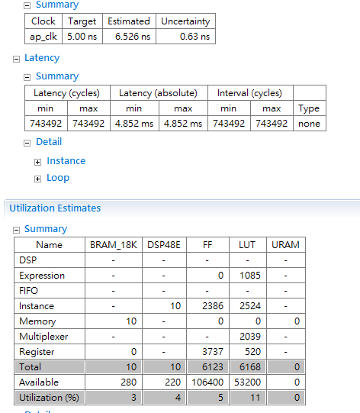
Abundance Estimator Baseline
Use floating point on Abundance Estimator
Clock period can’t meet 5ns
We want to further improve latency

Slide 6
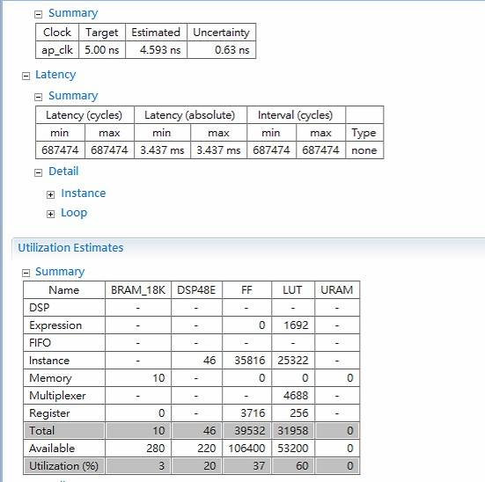
Optimization 1: 24-bit Fixed Point
Change floating point to 24-bit fixed point
Clock period can meet 5ns and latency reduce 29%
But hardware resources increase??

Slide 7
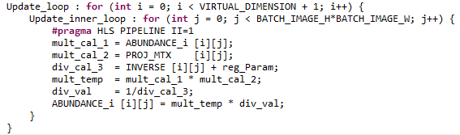
Optimization 1: 24-bit Fixed Point
Fixed point reciprocal generate a huge LUT
Size of LUT is growing exponentially over number of bits
Use Newton-Raphson method to solve it
div_val = 1/div_cal_3;

Slide 8
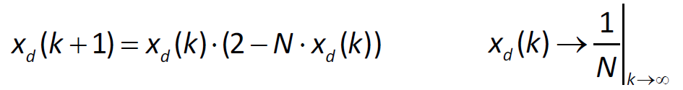
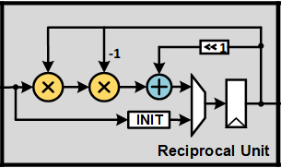
Newton-Raphson Method
Iterative algorithm
Quick convergence speed with good initial point
Simple hardware architecture

Slide 9
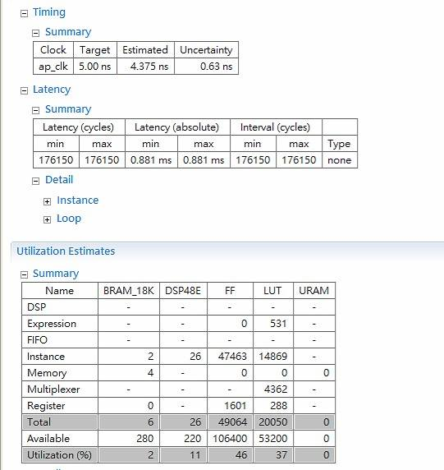
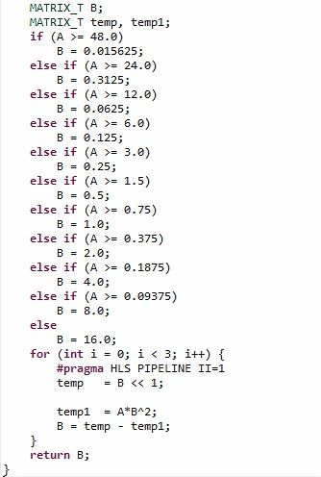
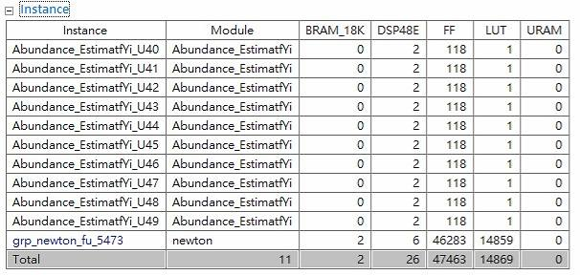
Optimization 2: Newton-Raphson Method
Latency reduces 74%
Hardware resource decrease
Still use many FF and LUT

Slide 10
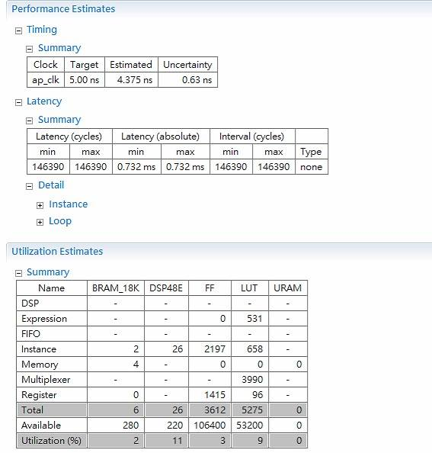
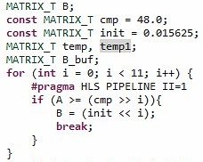
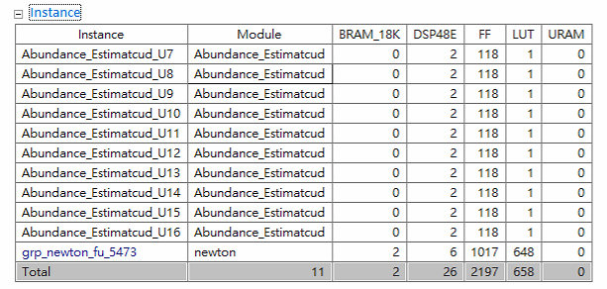
Optimization 3: Newton-Raphson Method Version 2
We find most of hardware resources come from initialization of Newton method
Reduce 93% of FF and 74% of LUT

Slide 11
Overall Improvement of Latency
Latency is about 0.732ms in this HSI dataset (256x256x8)
PSNR: 30dB

Slide 12
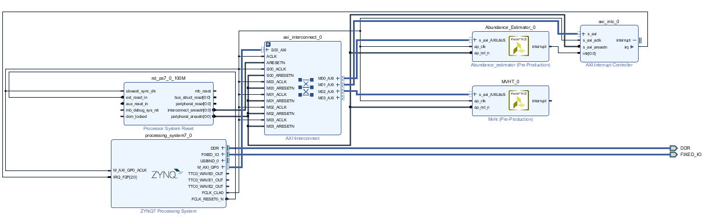
Block Design

Slide 13
Dataflow of Unmixing

Slide 14
Dataflow of Unmixing

Slide 15
Dataflow of Unmixing

Slide 16
Dataflow of Unmixing

Slide 17
Dataflow of Unmixing

Slide 18
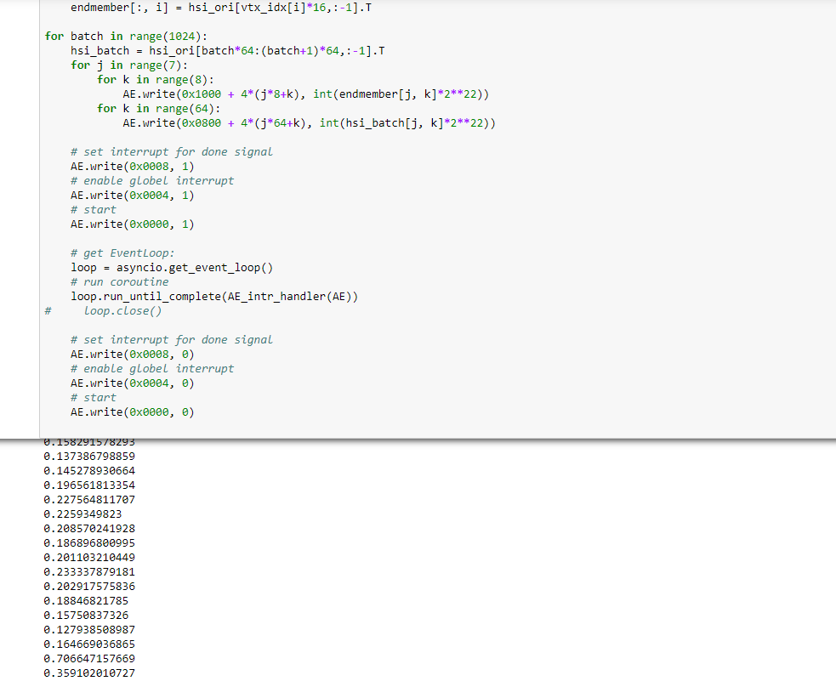
Python Simulation

Slide 19
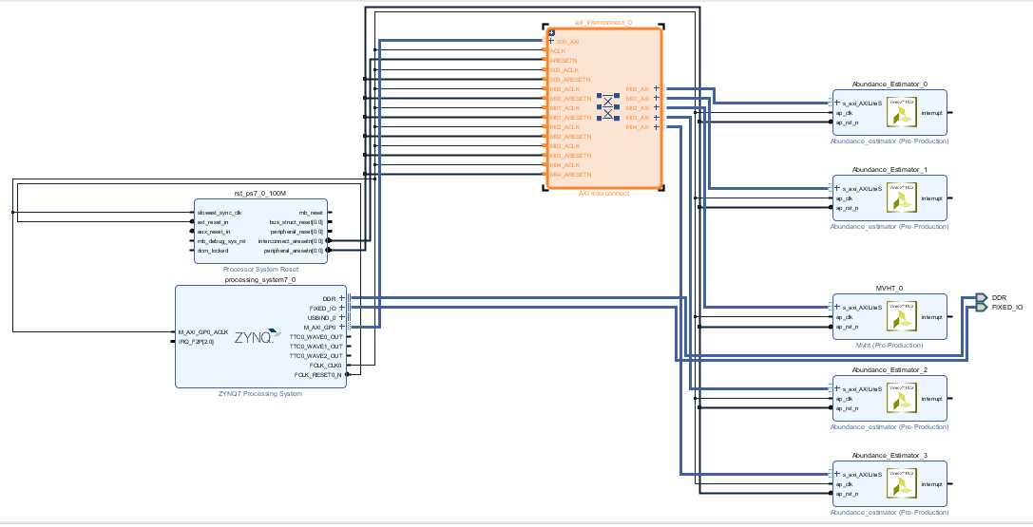
Block Design

Slide 20
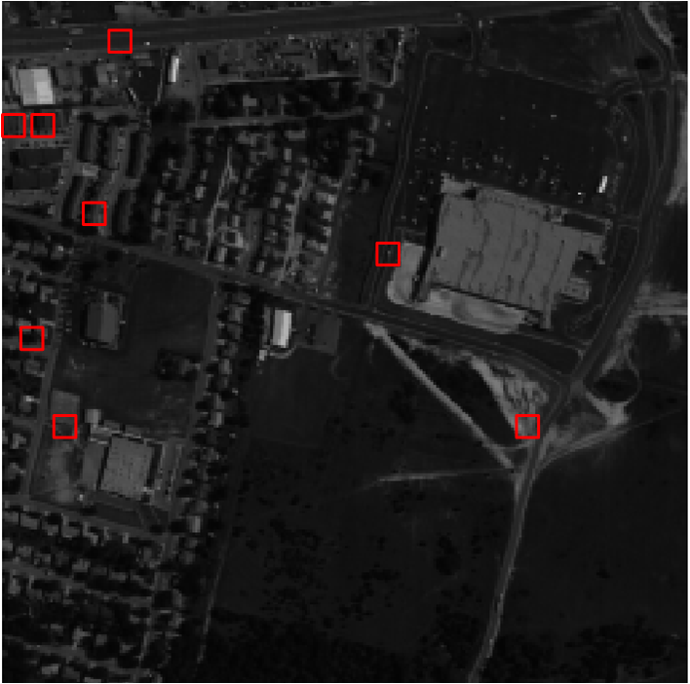
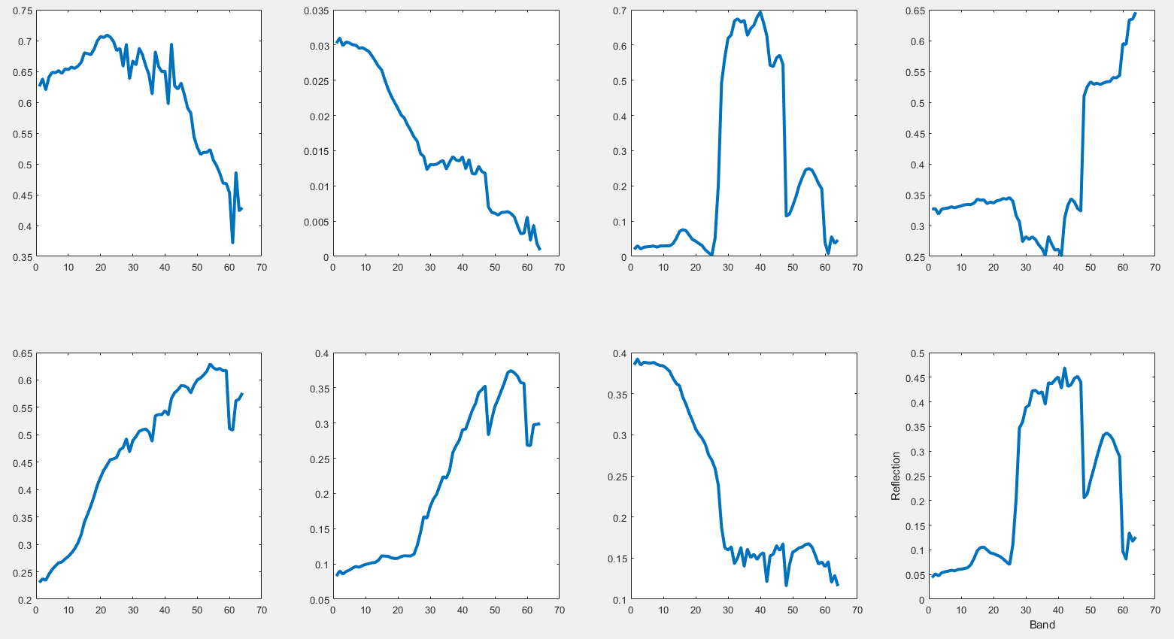
Output Result
Output result
One channel of input image

Slide 21
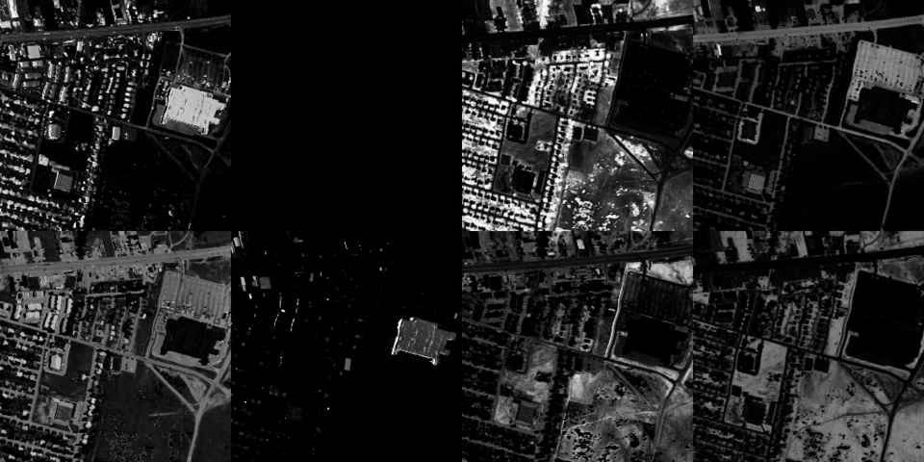
Ideal Running Result

Slide 22
Real Running Result

